Slide 1
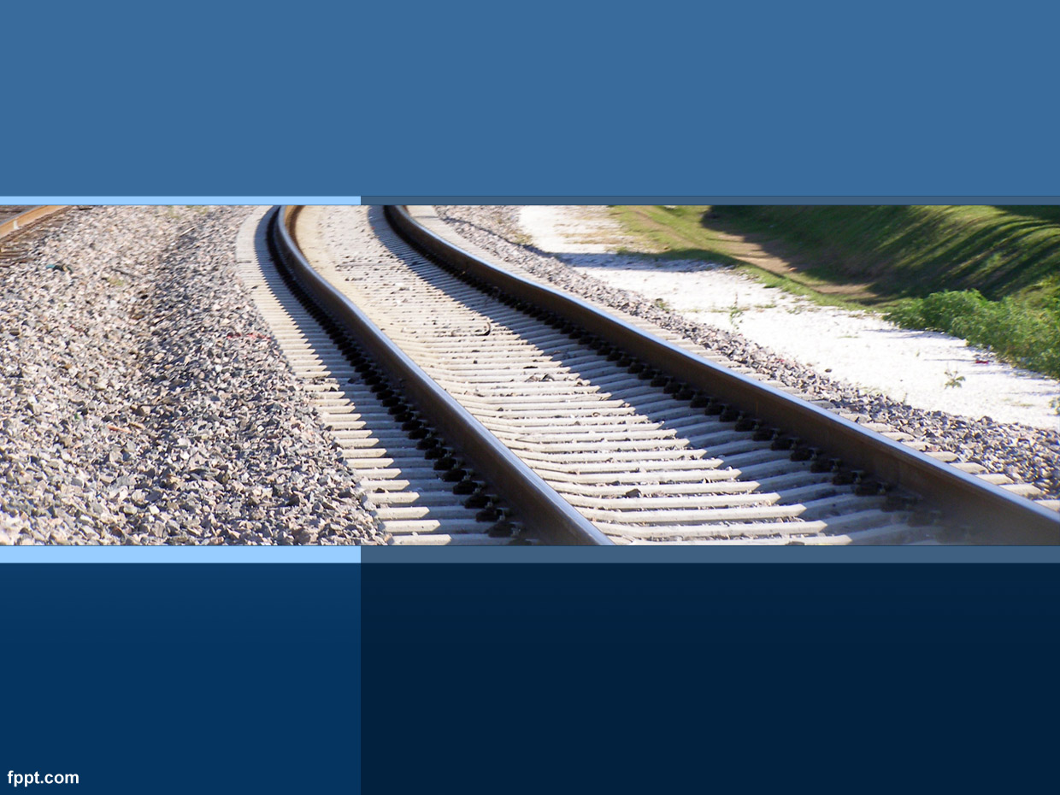
Railway Ticketing System
MyRTS
Railway Ticketing System
Anthony Dong
Alvin Wang
Jason Zeng
Allen Zhang
Anthony Dong
Arvin Wang
Jason Zeng
Allen Zhang

Slide 2
Outline
Introduction
Technologies
Database
Architecture
Program workflow
Demo
Future Works

Slide 3
Introduction
MyRTS
Railway Ticketing System is designed for simulating the real-world ticketing system to help people search and book railway tickets online. It also provides admin functionalities to manage orders.

Slide 4
Introduction
For users:
Register
Login
Transaction
Ordering and Ticketing Competition.

Slide 5
Introduction
For admin:
Order Management
Railway Management
User Management

Slide 6



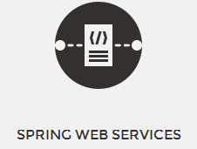

Technologies
Back-end

Slide 7




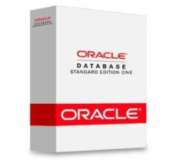

Technologies
Back-end

Slide 8


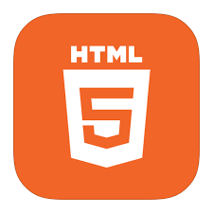
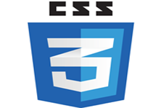

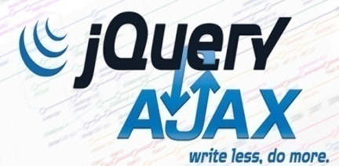

Technologies
Front-end

Slide 9




Technologies
Tools

Slide 10
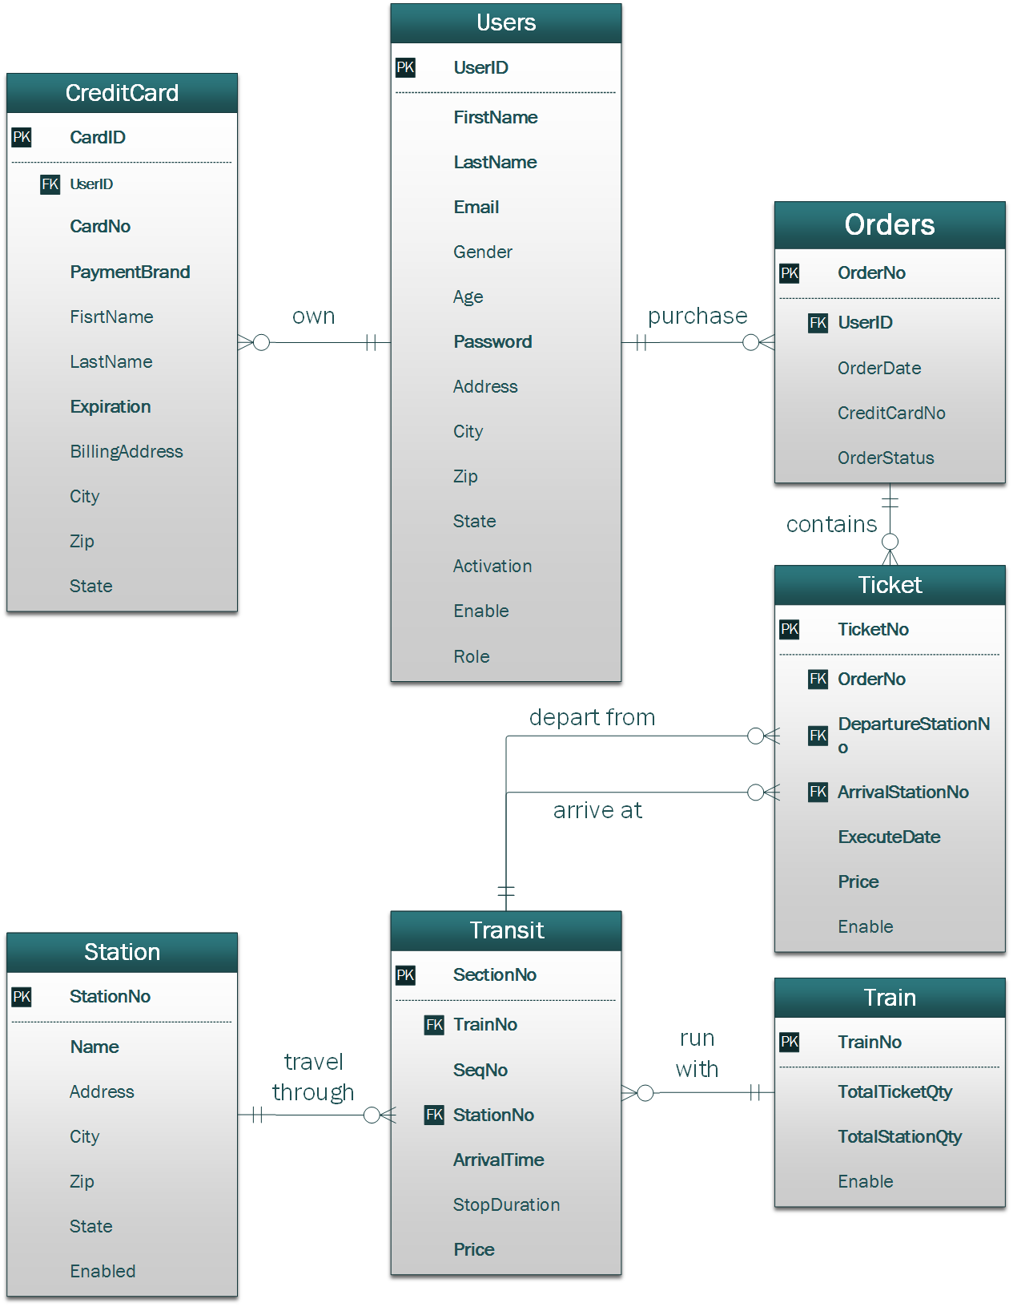
Database Design

Slide 11
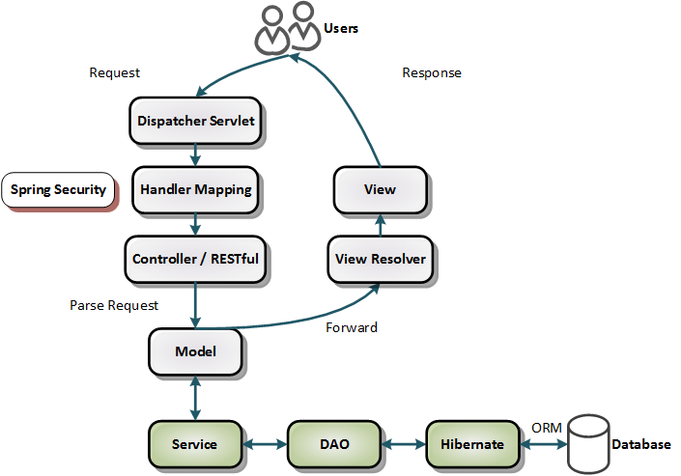
Architecture Design

Slide 12
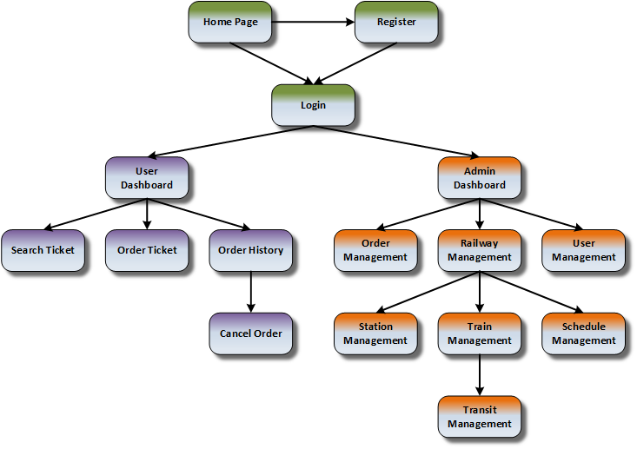
Program Workflow

Slide 13
Demo

Slide 14
Future Works
Distribute tickets intelligently.
Tickets Ordering Restriction Policy.
Searching Trains with Connection

Slide 15
Questions?

